Slide 1
LESSON 1
LEARNING
OBJECTIVES
Coordinates
on the Grid
Understand the (row, column) coordinate system
Map physical grid positions to coordinate pairs
Count intersections to determine robot position
Read and write coordinates accurately
AGENDA
What is a coordinate system? — 10 min
The grid and (row, col) convention — 10 min
Mapping exercise — 25 min

Slide 2

Hook
How Does a Robot
Know Where It Is?
“You can look around a room and know where you are.
How does a robot know its position?”
DISCUSSION
GPS Navigation
Street Addresses
Uses coordinates: latitude and longitude — two numbers pinpoint any location on Earth.
Use a grid: 5th Ave & 3rd St — two identifiers find any corner in the city.
Today: We’ll create a coordinate system for our robot’s grid — so it always knows where it is.

Slide 3
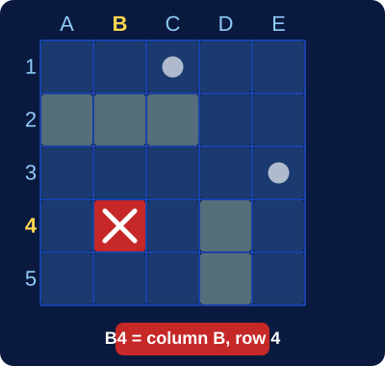
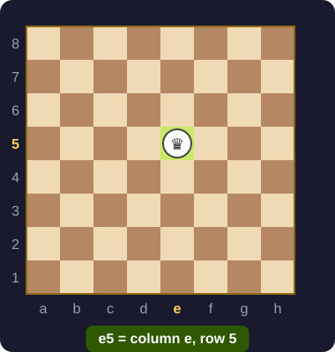
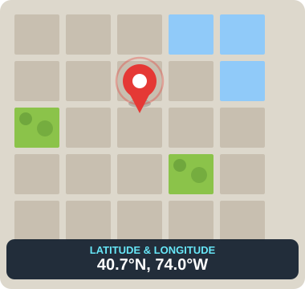
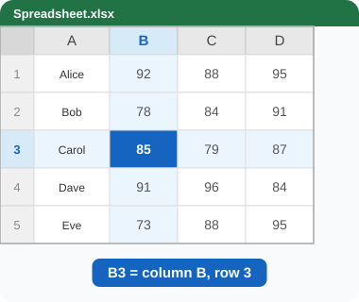
What Is a Coordinate System?
DEFINITION A way to describe any position using numbers
Battleship
Chess
"B4" = column B, row 4
"e5" = column e, row 5
Maps
Spreadsheets
Latitude & Longitude
Cell A1, B3, etc.
KEY IDEA Two numbers uniquely identify any position on a 2D surface.

Slide 4
Our Grid Convention — (row, col)
The XRP robot grid uses (row, column) pairs:
 | Col 0 | Col 1 | Col 2 | Col 3
Row 0 | (0,0) | (0,1) | (0,2) | (0,3)
Row 1 | (1,0) | (1,1) | (1,2) | (1,3)
Row 2 | (2,0) | (2,1) | (2,2) | (2,3)
Row 3 | (3,0) | (3,1) | (3,2) | (3,3)
CONVENTION
1st number = row
How far down
from the top
2nd number = column
How far right
from the left
Start at (0,0)
Top-left corner
is home base

Slide 5
Reading Coordinates
Practice: What are the coordinates?
(0, 0)
⚠ COMMON MISTAKE
Top-left corner
Mixing up row and column order!
(1, 2)
One row down, two columns right
(2, 3)
row 2, column 3
(3, 3)
Bottom-right of a 4×4 grid
(3, 2)
row 3, column 2
(2, 0)
Third row, first column
These are DIFFERENT positions!

Slide 6
The Physical Grid
Your robot drives on a physical grid:
(0,0)
(0,1)
(0,2)
Black tape lines form a grid on the floor
Each intersection is a coordinate
The robot uses line-following to travel between intersections
(1,0)
(1,1)
(1,2)
HOW TO COUNT
(2,0)
(2,1)
(2,2)
Start at (0,0) — the home position
Moving forward increases the row number
Moving right increases the column number
(0,0) = home • dots = intersections = coordinates

Slide 7
Why Coordinates Matter for Navigation
WITHOUT Coordinates
WITH Coordinates
"Go forward"
"Go from (0,0) to (2,3)"
"Turn right"
Robot calculates the path
"Go forward"
Change destination?
"Turn left"
Just change the numbers!
…
Hard to plan. Hard to change destination.
One mistake ruins the whole sequence.
Flexible. Powerful. The robot thinks — not just follows.
This is the foundation for Module 4 (Manhattan pathfinding) and Module 5 (Dijkstra’s algorithm).

Slide 8
Coordinates in Python
python
NEXT LESSON PREVIEW
row = 2
col = 3
print(“Position: row”, row, “col”, col)
Tuples
Python has a data type perfectly designed for coordinate pairs.
Access
Variables: simplest way to store a position
position[0] = row
position[1] = col
python
position = (2, 3)
print(position[0]) # row
Lesson 2
We’ll write code that creates and uses coordinate tuples.

Slide 9
Your Turn! — Map the Grid
Activity Steps
QUESTIONS TO ANSWER
1
Q1
What is the coordinate of the bottom-right corner?
Look at the physical grid (or diagram)
Q2
How many intersections are on a 4×4 grid?
2
Label every intersection with its (row, col) coordinate
Q3
If the robot is at (1,2), what is directly below it?
3
Answer the questions on the right →
Q4
What is directly to the right of (0,0)?
CHECKPOINTS
✓
Can you read any coordinate on the grid?
✓
Can you find a position from a coordinate?
✓
Do you know row vs. column order?

Slide 10
Connection to Next Lesson
WHAT YOU DID TODAY
LESSON 2: TUPLES
Learn about tuples — Python’s way to store coordinate pairs
Write code that creates and uses coordinate tuples
Build toward representing robot position in code
Learned the (row, column) coordinate system
Mapped physical grid positions to coordinate pairs
Practiced reading and writing coordinates
→
REMEMBER: Row first, column second — (row, col) — always!

